Slide 1
Face Emotion

Slide 2
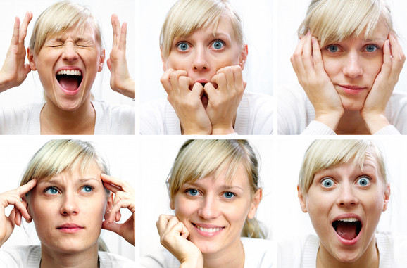
What is the face emotion?

Slide 3
Where you can use face emotion?
Self Driving
Uber
Caream
Race
Mall
Bank
Schools

Slide 4
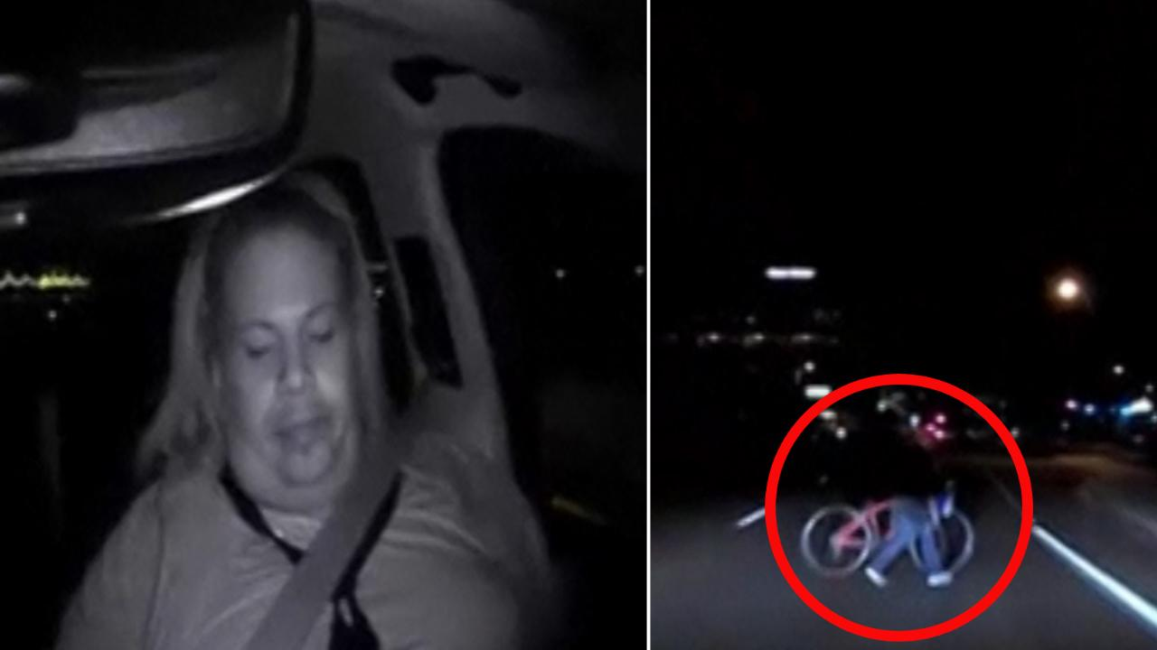
Uber

Slide 5
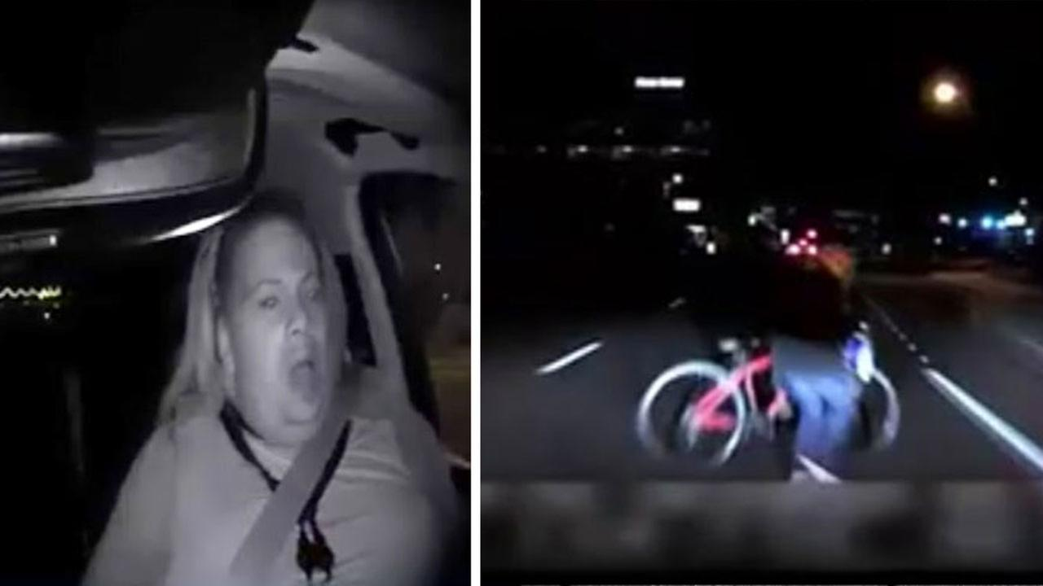
Uber

Slide 6
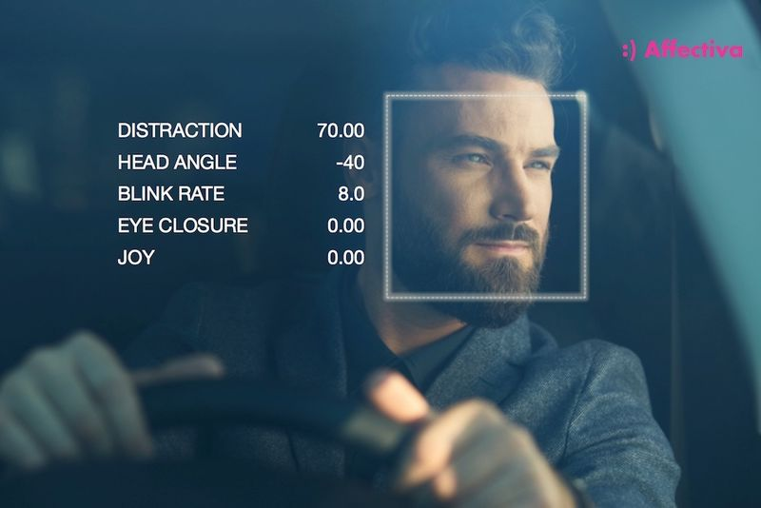
Real life problem

Slide 7
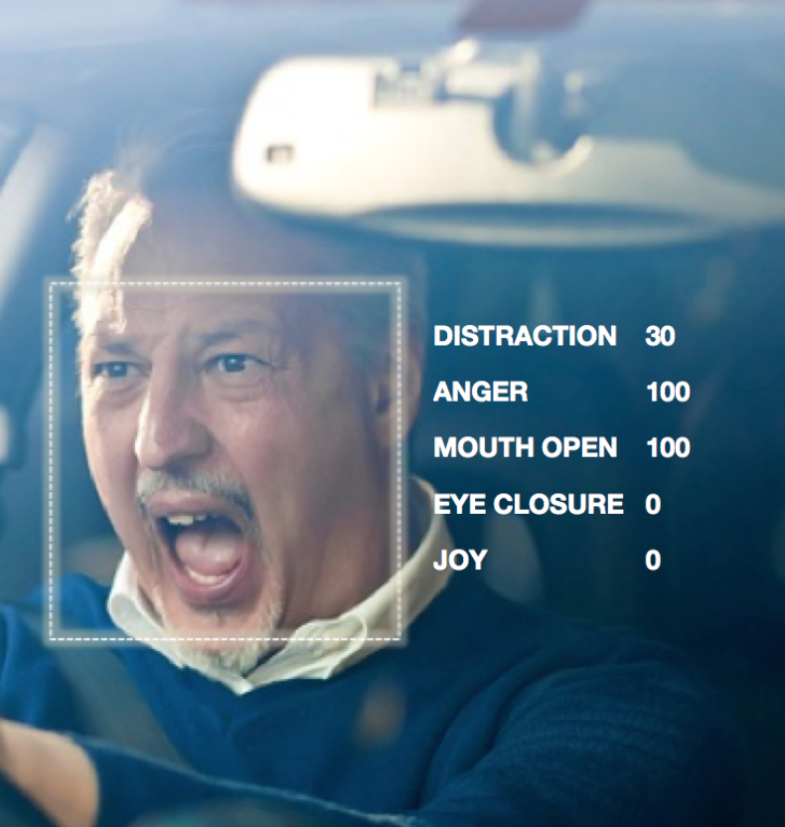
Real life problem

Slide 8
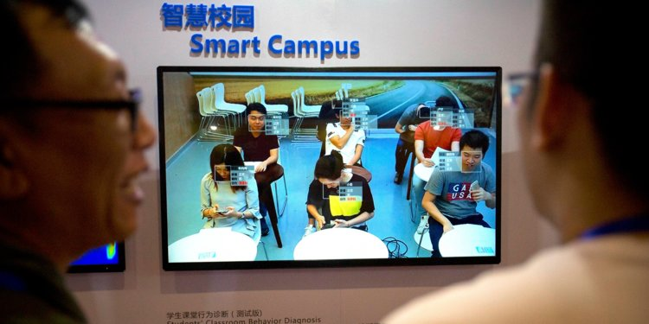
Schools

Slide 9
Algorithms and libraries that we will learn
NN
DNN
ANN
CNN
OpenCV & DNN
Keras
Tensorflow

Slide 10
NN

Slide 11
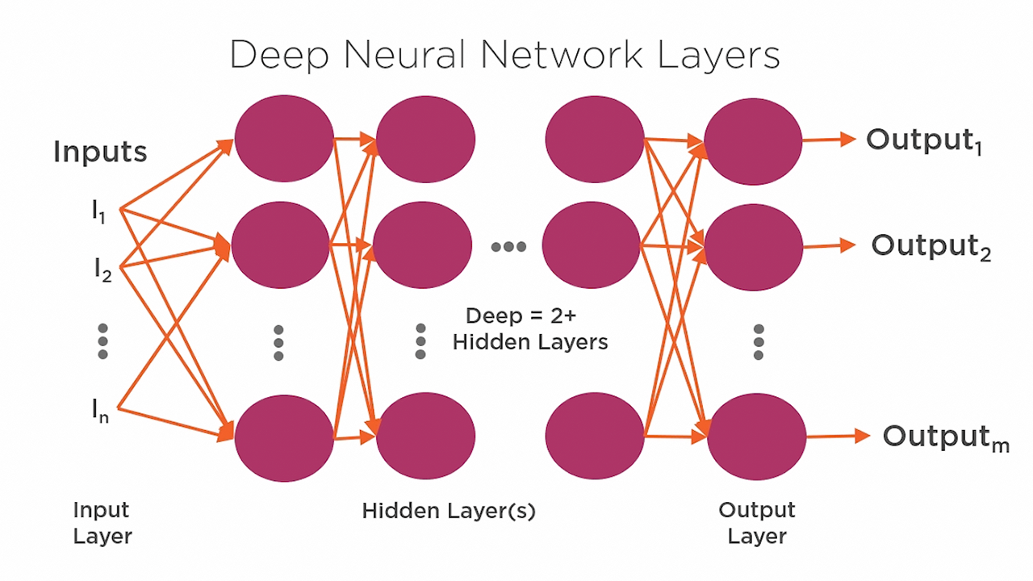

Slide 12
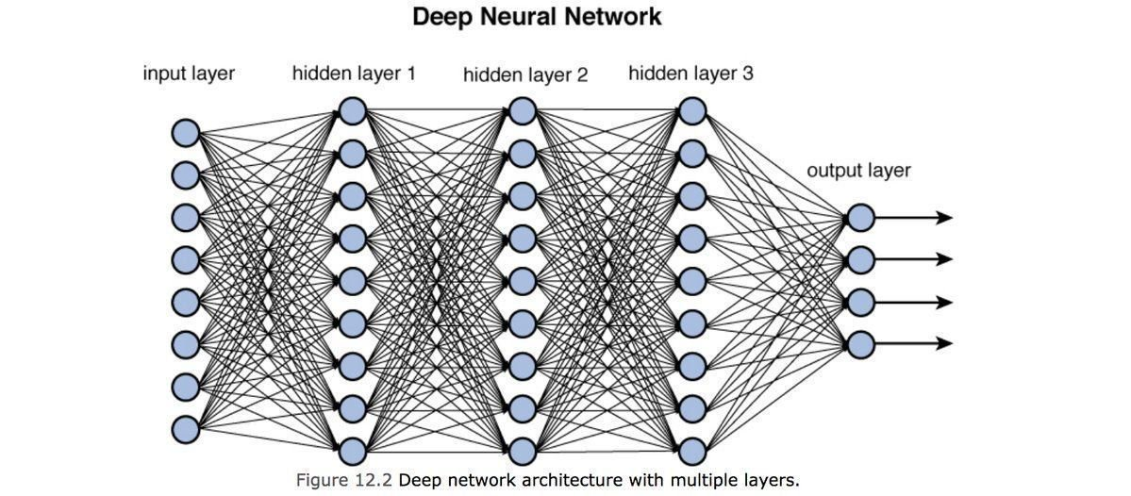

Slide 13
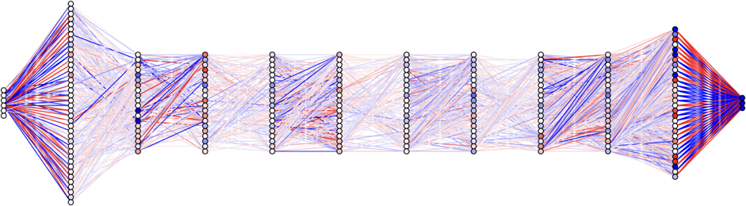
DNN

Slide 14
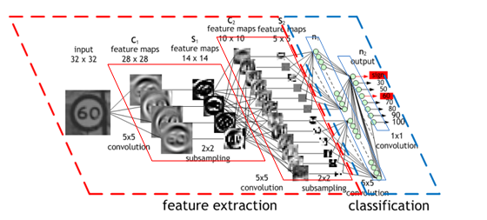
CNN

Slide 15
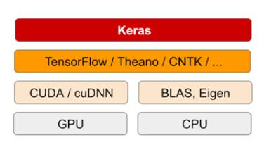

Slide 16
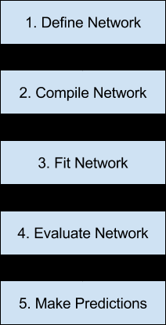

Slide 17
